Slide 1


SDLC and Cloud Native Development
Dr Duncan Fyfe and Jordan Bruno

Slide 2
Session Structure
Python Software Development Environment
AI Tools and Digital Development
Cloud Native Design Patterns

Slide 3


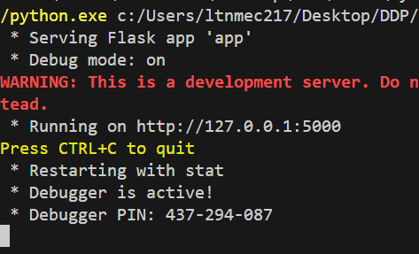
Flask Clarification
127.0.0.1:3000
127.0.0.1:5500
127.0.0.1:5000

Slide 4
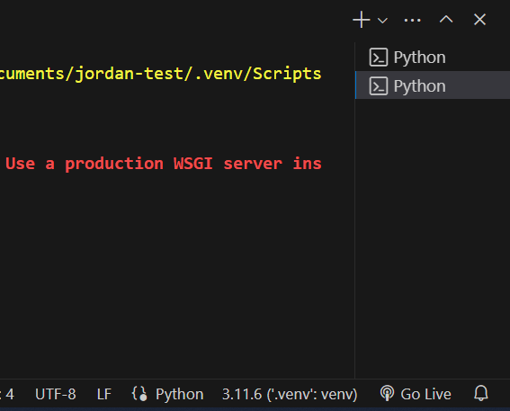
Already running ?
Existing Terminals

Slide 5
Python Software Development Environment

Slide 6
VSCode – Keep It Separated
One folder per project
One project open at a time in a VSCode window
[Windows Only] Add a settings.json file (next slide) to the project folder to give PowerShell permission to create the virtual environment
Use a separate python virtual environment per project

Slide 7
VSCode – Installation for Python
Install Python3 (Flask needs version 3.8 or newer):
https://www.python.org/downloads/
Python2 is incompatible with python3. You MUST use a version of Python3.
Install VSCode:
https://code.visualstudio.com/
Open VSCode, install the python extension
https://marketplace.visualstudio.com/items?itemName=ms-python.python

Slide 8
VSCode – New Python Project
Create a folder:
Example: MyFlaskPMA_2024
Open the folder in VSCode:
MENU File → Open Folder… → Choose the folder created above
Download “Duncan’s Flask File” from week 4 of the moodle.
Unpack flask_content.zip file; copy the files into VSCode

Slide 9
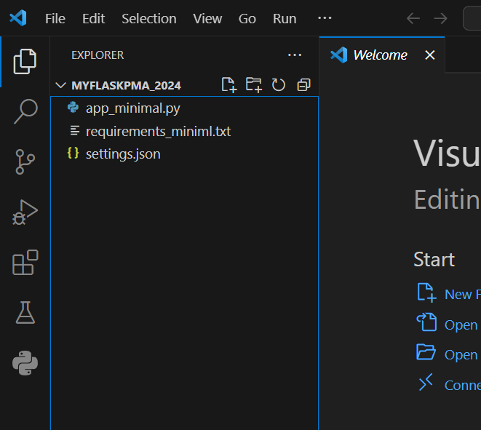

Slide 10

[Windows Only] settings.json
Create a settings.json file in the top-level project folder and add the text below
{
"terminal.integrated.profiles.windows": {
"PowerShell": {
"source": "PowerShell",
"icon": "terminal-powershell",
"args": ["-ExecutionPolicy", "Bypass"]
}
},
"terminal.integrated.defaultProfile.windows": "PowerShell"
}

Slide 11
Python Requirements
Python requirements are additional libraries you want to use which do not come prebuilt into python.
sqlite3 is a built-in library
Flask is an external python library
Requirements are listed in a top-level file:
requirements.txt
The Requirements can be installed by running the following in a terminal:
pip3 install –r requirements.txt

Slide 12
Python Requirements
One requirement per line. Below is the minimum requirements.txt for a Flask app with unit tests:
markupsafe==2.1.1
pylint
pytest
Flask
NB. The line markupsafe==2.1.1 explicitly sets an older version of markupsafe. This isn’t usually needed but some laptops were failing to install the latest version. This version works just as well for our needs.

Slide 13
Create A Python Virtual Environment
Copy or rename requirements_miniml.txt to requirements.txt
Control+Shift+p / Command+Shift+p
Type Python:Create Environment
Select Venv option from drop down menu.
Select choice of python
Tick the “requirements.txt” box
Click OK

Slide 14
Flask Setup
In your to-level folder:
Create an empty file: app.db
Create a folder: templates
Create a folder: static
Create a folder: tests

Slide 15
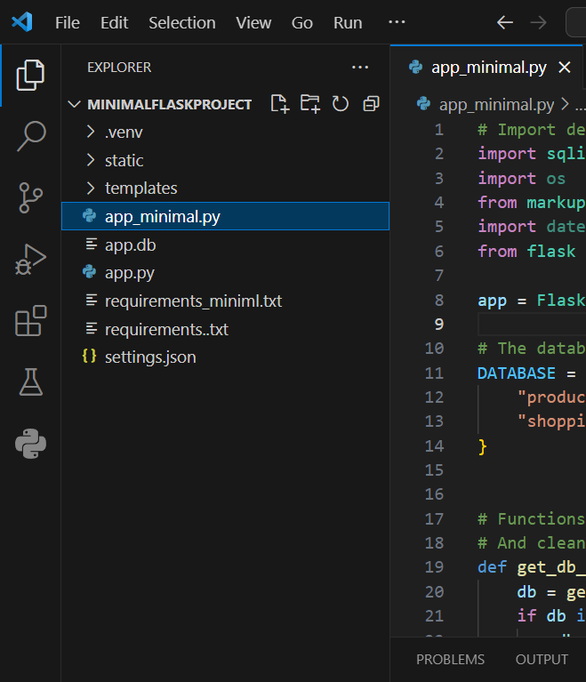

Slide 16
Confirm It Works
Open a terminal (to see output from the application)
MENU Terminal → New Terminal
Run the application ()
MENU Run → Run Without Debugging
The terminal should show the output from the application. It should include the phrase “Hello, World!”.

Slide 17
Flask Setup
In your to-level folder:
Create a file: app.py
This is where your flask application code will go.
Use sqlitestudio to connect to the empty file app.db as an sqlite3 database.
As an empty file it is a valid database with no tables

Slide 18
Flask Setup
In your to-level folder:
Create a file: app.py
This is where your flask application code will go.
Use sqlitestudio to connect to the empty file app.db as an sqlite3 database.
As an empty file it is a valid database with no tables

Slide 19
Session Structure
Python Software Development Environment
Interface Design
AI Tools and Digital Development
Cloud Native Development

Slide 20
Application Programming Interface (API)

Slide 21
CRUD
Four Basic Functions for any resourse:
Create
Read
Update
Delete

Slide 22
Mapping from CRUD to Flask API and User Interfaces
Resource
Function
HTTP
Method
CREATE
POST
READ
GET
UPDATE
PUT
DELETE
DELETE

Slide 23
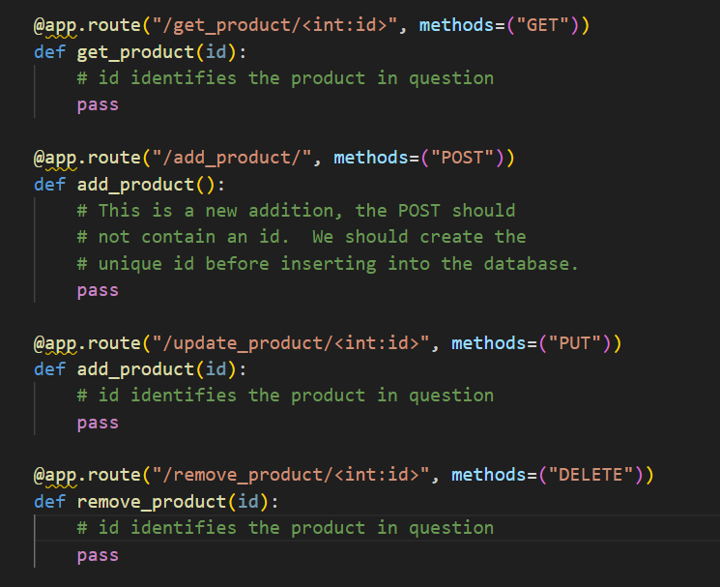

Slide 24
RESTful API
Representational State Transfer (REST)

Slide 25
RESTful API
Use a uniform interface
Client-Server Interaction
Client takes care of request gathering and UI
Server takes care of data access, workload and security
Stateless Operations
Exchange between client and server must contain all necessary information
Exchange includes other usable API

Slide 26

Product Catalogue
Search
Web UI
Shopping Cart
Currency
Exchange
Add
Remove
Inventory
Buy
Service

Slide 27
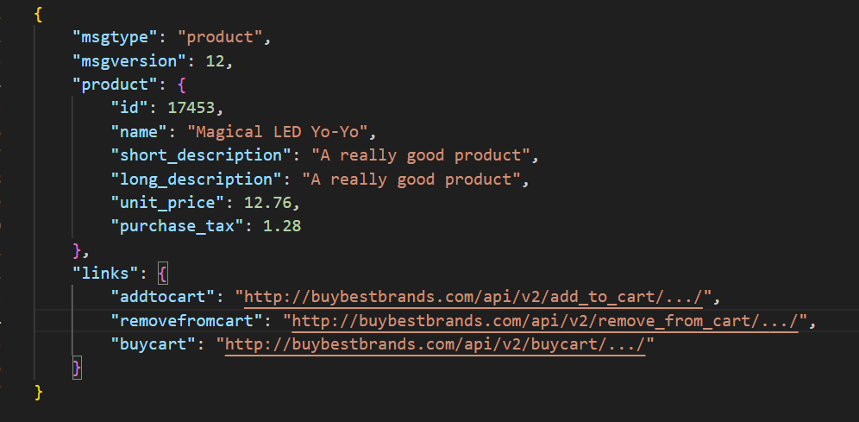

Slide 28
Session Structure
Python Software Development Environment
Interface Design
AI Tools and Digital Development
Cloud Native Development

Slide 29
AI Tools and Digital Development

Slide 30
AI Tools – Today
New AI based digital development tools are available:
Github CodePilot
ChatGPT
Specialized ChatGPT
Midjourney
AI Tools are improving fast.
They can be helpfull but the current output often needs testing and cleaning before use.

Slide 31
AI Tools – And You
How do you ask AI tools the right questions ?
AI tools return pieces of a puzzle.
Sometimes pieces of the wrong puzzle, how do you know ?
AI tools do not (yet) put the pieces together.
AI tools can make development cheaper (faster)
Does this means fewer developers (fewer jobs)
If ChatGPT answers perfectly, who needs you ?

Slide 32
AI – The Future
AI will impact everything:
Digital Product Development
Marketing and Sales Channels
Music and Image Creation
Teaching
Fashion
How we shop
Customer Service

Slide 33
AI – The Future
2000s -- companies bought large number of domain names because they thought it was important.
2010s -- nobody uses domain names, they search on Google.
2020s Nobody searches on Google, they ask ChatGPT
2030s Nobody asks ChatGPT because an AI agent has already found and provided the answer ?

Slide 34
Session Structure
Python Software Development Environment
AI Tools and Digital Development
Cloud Native Development

Slide 35
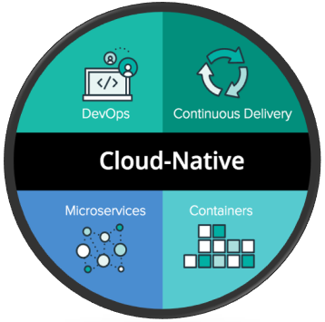
4x Pillars of Cloud Native

Slide 36
Examples Development
A smartwatch AI fitness instructon

Slide 37
A Smartwatch AI Fitness Instructor
A Startup putting an MVP into production
Receive data from smart watches
Improve the MVP AI model with real data
Combine new and historical data using our best-in-class AI model
Send feedback to the watch wearer about their workout.
Our customer is a health insurer. Their health policy holders are encouraged to use our app.

Slide 38
Why Cloud Native ?
A customer has need of a computing application which add value for them.
Reliable
Maintainable
Scalable
Agile
Understandable
Reproducible
Reusable
Compliant
Affordable

Slide 39
Externalities
Customer Needs
SLA, performance, priorities, branding
Operational Needs
Billing, CRM, out-of-hours support, high-availability
Regulatory and Legal Considerations
Data protection, Medical device certification
Costs

Slide 40
Externalities: A Smartwatch AI Fitness Instructor
A Startup putting an MVP into production
Customer and user needs likely to change
Expanding teams means changing culture and practices
Improve the MVP AI model with real data
AI modelling needs different computer resource from day-to-day.
Combine new and historical data using our best-in-class AI model
Does health data need regulatory considerations ?
Our customer is a health insurer. Their health policy holders are encouraged to use our app
Some CRM functionality will be required
What is the position with respect to financial regulations ?

Slide 41
Cross-cutting Concerns
Legal and Regulatory Requirements
Risk-Management
Asset Management and Cost Control
Security
Logging
Monitoring and Metrics
Testing

Slide 42
System Engineering (The Product)
Cross-cutting mistakes can be expensive to fix later – they impact many parts
Gather and estimate systems data; understand system needs
Network traffic; how much; from where ?
Data storage; immediate and long term
Simultaneous customers
Responsive; near real-time or batch processing ?

Slide 43
System Engineering (The Cloud)
Read cloud service provider docs
Do services support the product needs ?
Which costs can go to zero (serverless); keep growing (e.g. long-term data storage)
Are there service limits which impact the design e.g. AWS lambda invocation payload limit: 6MB
Use systems data to create cost estimates
How will ongoing costs grow ?
Is our estimated per-transaction cost within budget ?
Is our estimated per-customer cost within budget ?

Slide 44
Sources of Truth
What does the customer want ?
What infrastructure has been deployed ?
What code is running in production ?
What data is trustworthy ?
Where can I see the production logs and monitors ?
What work needs to be done ?
Where do we document architectural decisions ?
Which user or client documentation is current ?

Slide 45
Useful Questions
What is the scale of the application (e.g. customers, servers, etc.)?
How secure is the data/app?
How regulated is the data/app/domain?
What are the future plans for the app?
How ‘cloud native’ is the app?
Is the app in active development?
Does it rely on proprietary software/hardware?
How easy is it to modify the app?
Could the app performance be improved?
How well documented is the app?
Replace

Slide 46
Useful Questions
How easy is it to find viable alternatives to the application?
What tech stack supports the app?
Do other apps/services depend on this app?
How is the app monitored?
Is the application user-facing?
How does the app manage sessions and state?
What is the maintenance effort to support the app?
What protocols does the application currently employ?
How important is the app to the business?
How much downtime for servicing is tolerable?
Replace

Slide 47
DevOps: Continuous Everything

Slide 48
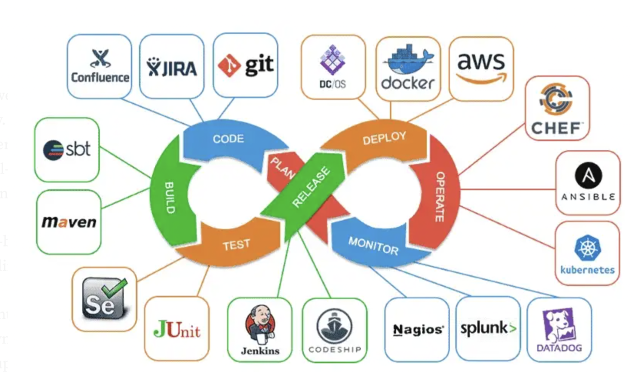
Continuous Integration/Delivery

Slide 49
Source Control Management
Track, organize and manage code changes
Isolate parallel developments
Manage concurrent change sets
Examples: subversion, mercurial, git
As a service: BitBucket, GitHub, GitLab

Slide 50
Workflow with CI Cycle
SCM
Fork Feature Branch
Feature Development
Feature
Branch
Automatic
Raise
PR
Commit Change
Code Quality
Checks
Unit
Testing
Feature Release
Automatic
Pull
Request
PR
Review
Merge
Feature Branch
Build
Testing
Release

Slide 51
Integration, Delivery and Deployment
Integration
Automated build and test of features as they are merged into the main branch.
Delivery
When triggered the release and deployment to a test or production environment is automated.
Deployment
No trigger necessary. Merging of a feature triggers automated deployment.

Slide 52
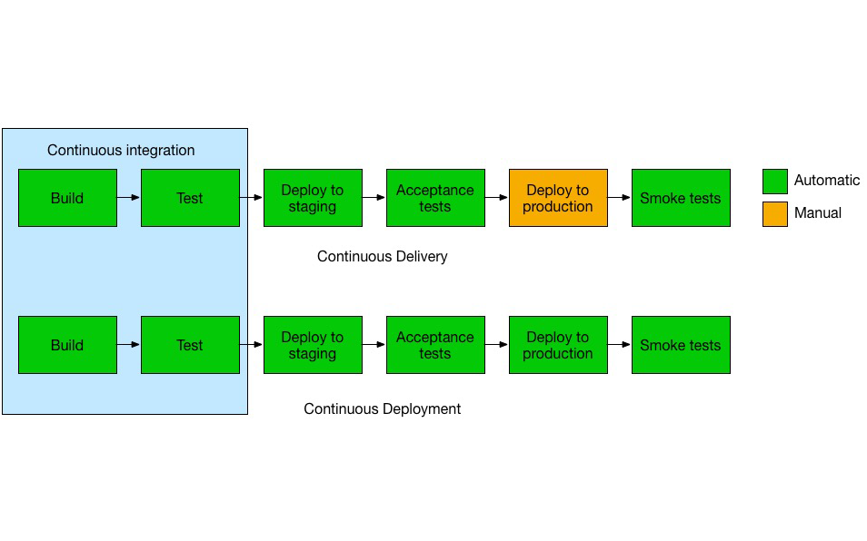

Slide 53
What is a Container ?
Virtual Machines are isolated hardware and software-wise from the physical host.
Containers describes system interfaces which must be satisfied by the host e.g. networking
Containers sit on top of the host operating system
A container embed a distributable package of software and its dependencies.
Container
Service
Libraries
Interfaces
Operating System
Hardware

Slide 54
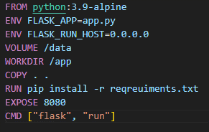
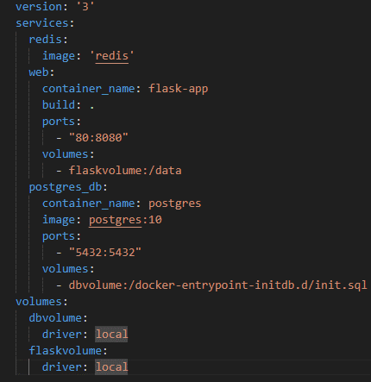
Container Definition
Container Composition

Slide 55
Containerized Microservices
Container
Registry
Microservice
Microservice
Service
Coordinator and
Manager
Microservice
Microservice
Microservice
Microservice
Microservice
Microservice
Console
Microservice
Virtualized Cluster
Physical Hardware

Slide 56
Why a Container ?
Monolith
SDLC of every feature has to move in unison
Update libraries to fix a bug in one place can introduce bugs into another
Monolith needs permission to do everything
Microservices / Serverless
SDLC of each microservice is disconnected
Each service has independent libraries
Each service has independent security permissions
Separate “contained code” from physical hardware
Send the service (micro) to the data (large)
Developers can define “system” for operations (DevOps)

Slide 57
Continuous Integration/Delivery
Embeds best-practice, expertise and team standards in a reproducible process
As a service, try it!
https://circleci.com/continuous-integration
CI/CD + Orchestration ➔ The staging environments mirror the production environment
CI/CD + Containers ➔ The software in production matches the software in staging.

Slide 58
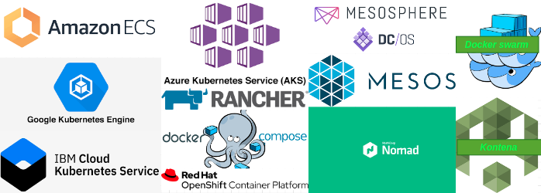
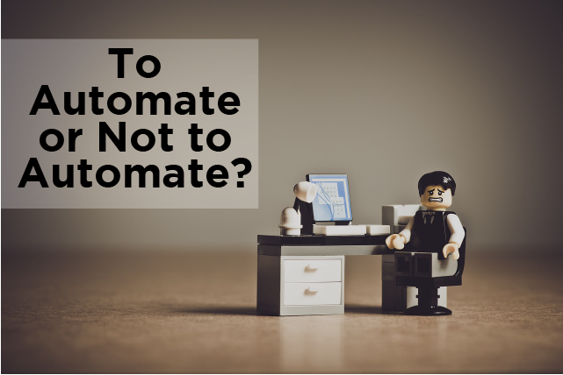
Container Solution

Slide 59
DevOps: Team Organization

Slide 60
4.1 Conway’s Law
The software architecture, results from the organization of the teams

Slide 61
4.2 Siloed Development Teams
Developers
Analysts
Backend
Developers
Acceptance
Testing
Front end
Developers
Operators
Scheduler
Storage
DBA
Operators

Slide 62
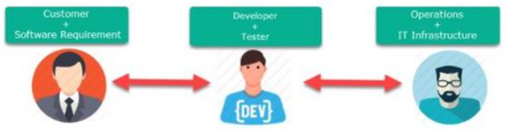
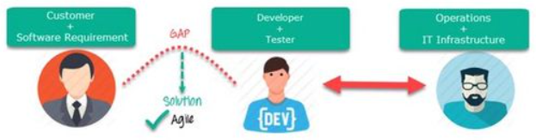
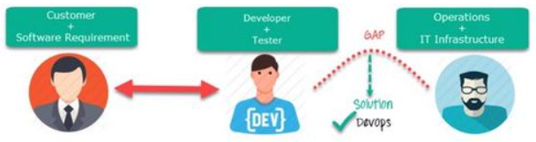
Dev but DevOps

Slide 63
Evolving DevOps – Be Agile
Seek to learn from others
Ask, don’t assume
Aim to automate all DevOps processes (CI/CD++)
An expected error is a feature, not a mistake – disks will fill up, networks will go down; the application must fail safe (and tell you about it)
If uncertain make a prototype -- try fast, fail fast; you will learn from your mistakes than from your successes
Don’t let anyone become indispensable!

Slide 64
A DevOps Conundrum
Multi-skilled or jack-of-all-trades team members are desirable
Some developers want to master their trades
An iPhone developer will not take kindly to being told to program a backend system
Some components may need mastered trades
User Interfaces
AI/ML Modelling
Cutting-edge skills today are run-of-the-mill tomorrow

Slide 65
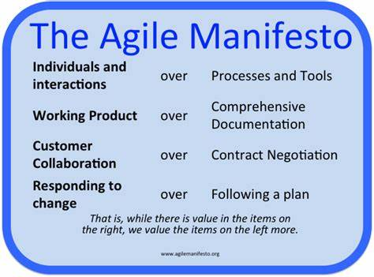
Agile 1.0

Slide 66
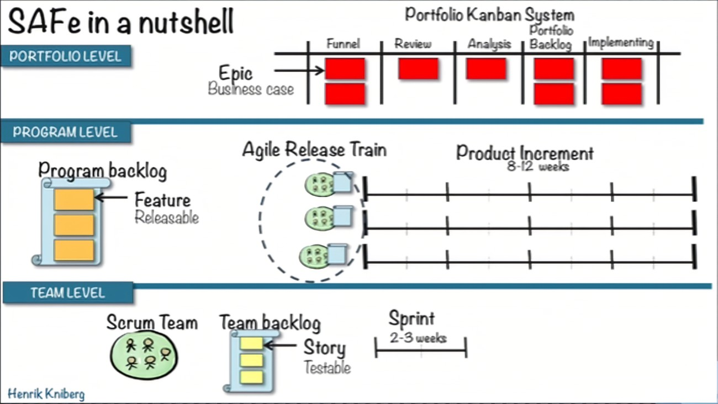
Agile 2.0

Slide 67
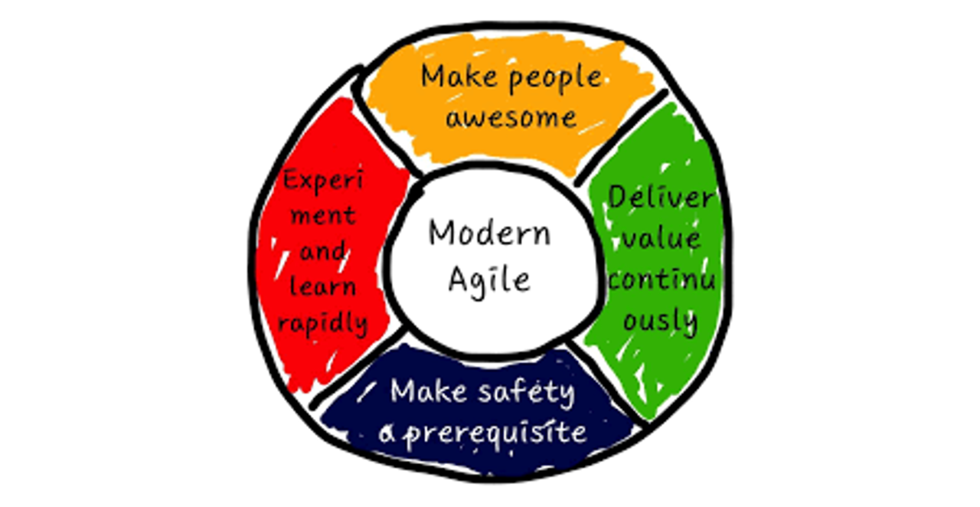
4.6 Agile 3.0

Slide 68
Agile 3.0
Automate everything (you can): eXtreme Programming bought automation to agile (e.g. automated tests). In cloud-native we automate infrastructure, scaling, integration and deployment
Important things shouldn’t live in one place: agile teams spread expertise and know-how (human glue) through a ‘development’ team; stateless services (where possible) decouple software and hardware and provide more availability and resilience

Slide 69
Agile 3.0
Security throughout: mixed agile teams (cf: DevSecOps) bring security concepts into design and development; cloud-native demands “defence-in-depth” as everything is online and interconnected (everywhere is a doorway)
The only constant is change: the agile manifesto taught us to embrace change and changing requirements; a cloud-native platform is less the statefull, fixed environment and more a living and growing organism

Slide 70
DevOps: Design Patterns

Slide 71
Architectural Design Diagrams
A picture paints a thousand words!
Modelling tools and “languages” exist to help express ideas, designs and flows.
Cloud-useful diagrams include:
State (Transition) diagrams
Use Case diagrams
Sequence diagrams
Data-flow diagrams
Architectural Decision Record
Describes why choices were taken over others, in context and with consequences.

Slide 72
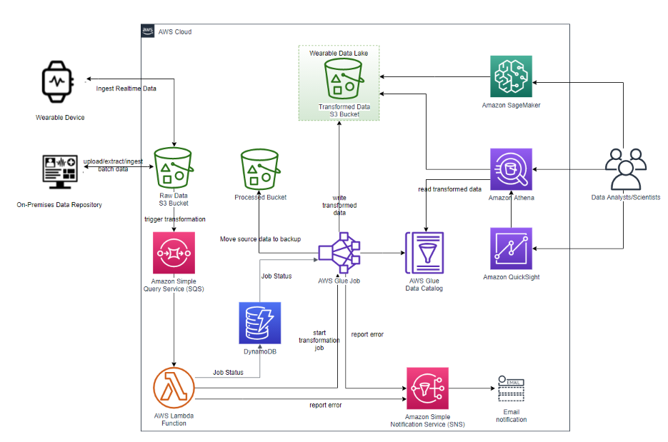
Architectural Design Diagrams: A Smartwatch AI Fitness Instructor

Slide 73
Design Patterns
When you look at multiple software systems, you often find recognize similarities. A set of program elements work together in roughly the same way in lots of different places, even if masked by different names and incidental variations in behavior. Experienced programmers learn how to solve common problem in particular ways […]
Therefore: in the early 1990's, a bunch of people in the software world developed the idea of software patterns to capture these common solutions. By writing them down, in a somewhat structured format, we can better share this otherwise implicit knowledge.
https://www.martinfowler.com/articles/writingPatterns.html

Slide 74
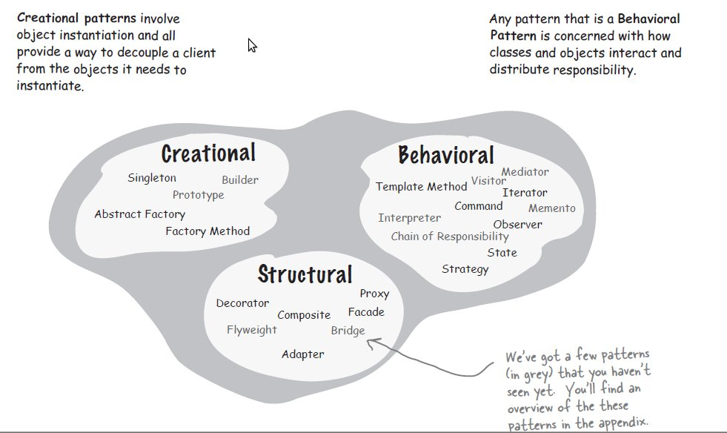
Design Patterns

Slide 75
Evolving Patterns – Be Agile
Seek to learn from others
If uncertain make a prototype -- try fast, fail fast; you will learn from your mistakes than from your successes
Best practice for implementing design patterns in the cloud evolve as new services come on-line -- keep learning.

Slide 76
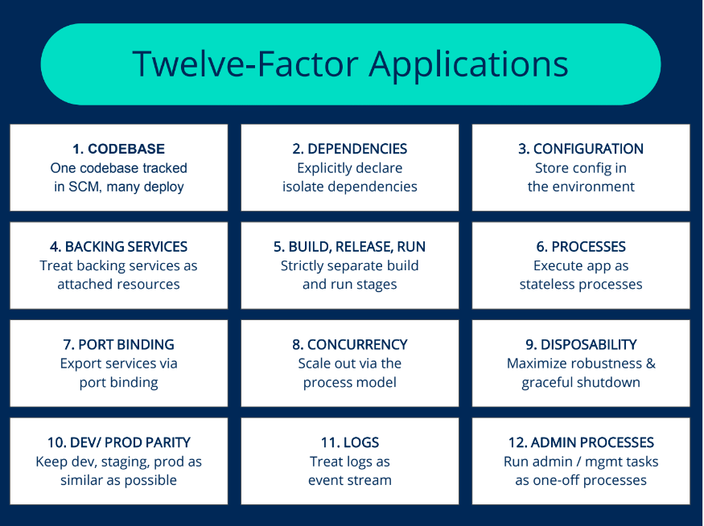
12-factor Apps
https://12factor.net

Slide 77
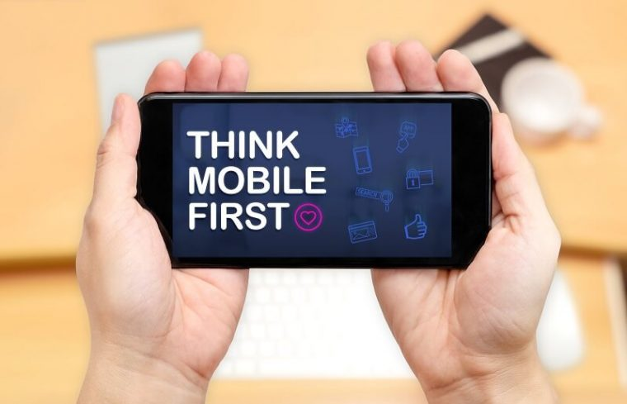
BONUS! Think APIs First

Slide 78
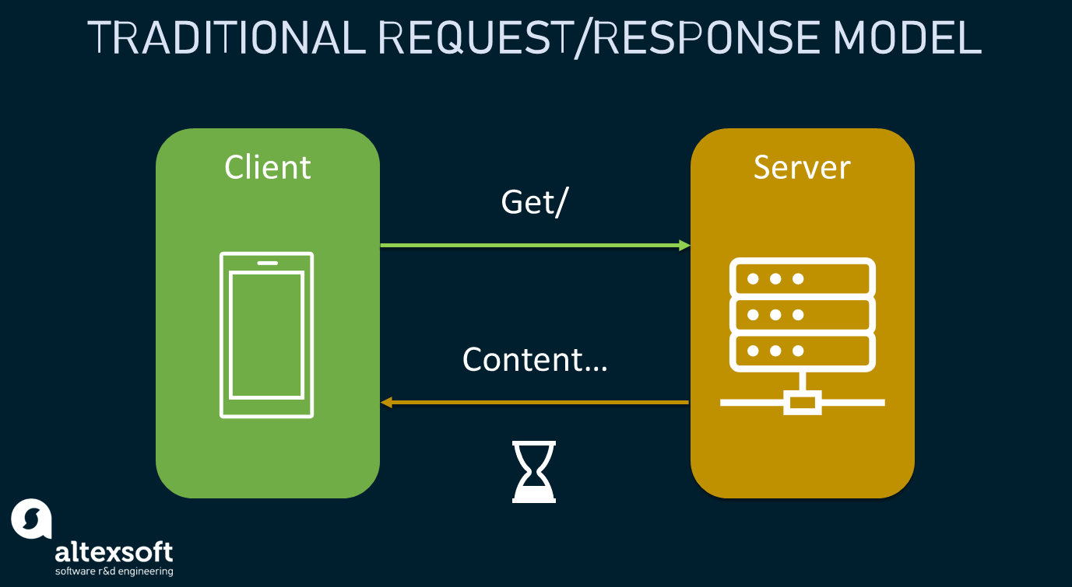
The Pub-Sub Pattern

Slide 79
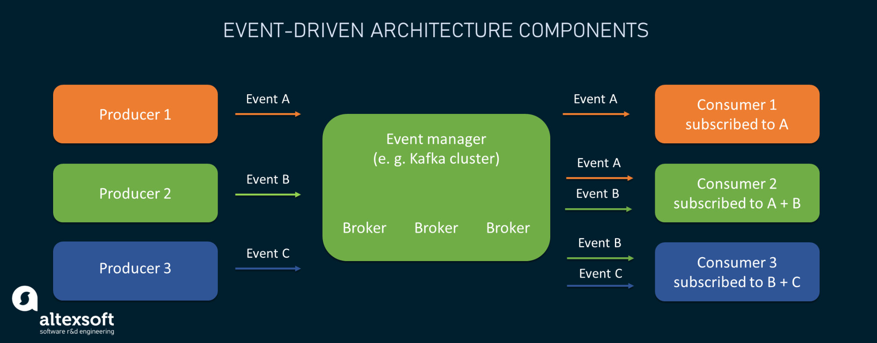
The Pub-Sub Pattern

Slide 80
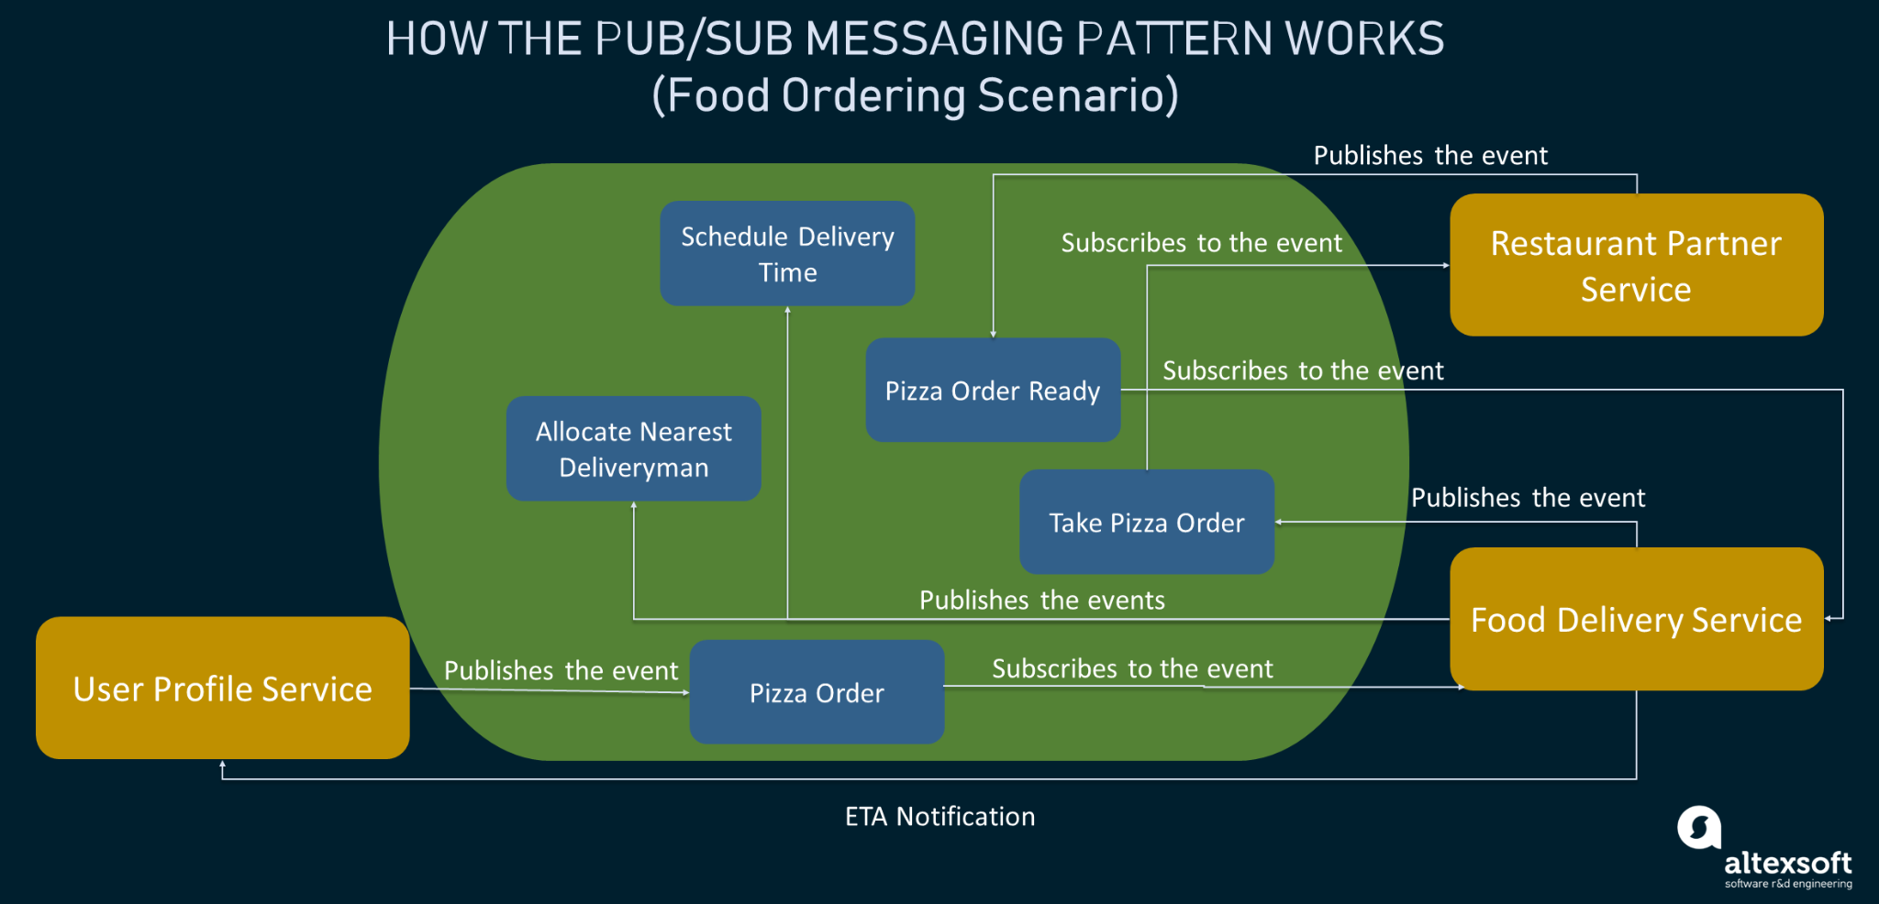
The Pub-Sub Pattern

Slide 81
Pub-Sub Service Update
Message Broker
Current Microservice
Message Broker
Queue
Microservice Under Test
Message Broker
Queue

Slide 82
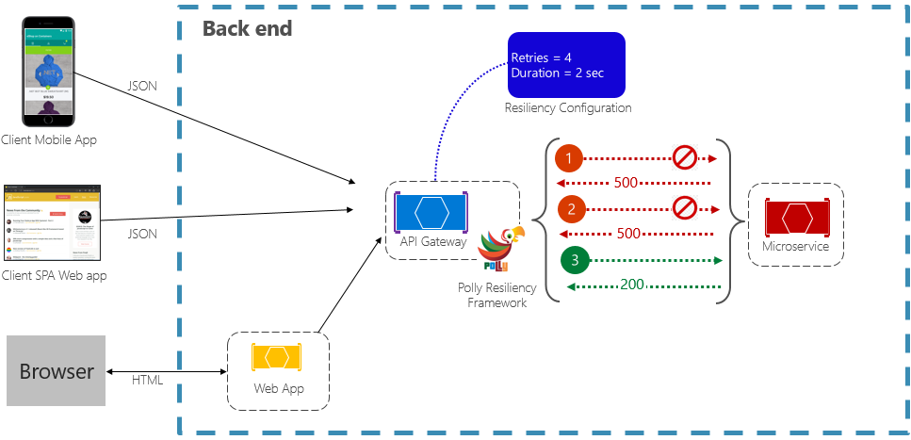
The Circuit Breaker Pattern

Slide 83

Questions?

